Slide 1
To use and manipulate vectors to represent forces
Success Criteria
I can calculate a resultant vector.
I can resolve a resultant vector into its components.

Slide 2
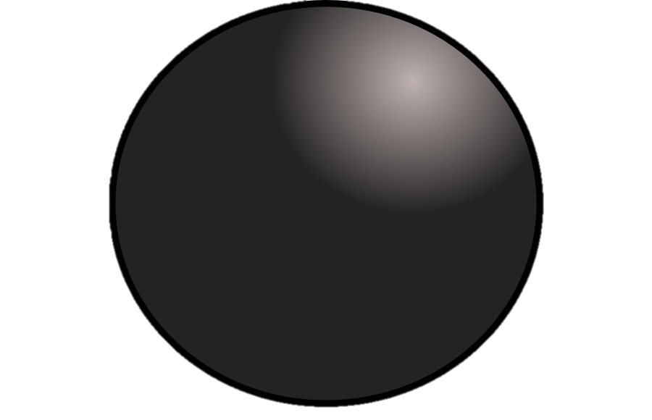
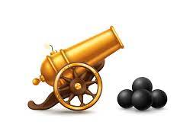
To use and manipulate vectors to represent forces
Why vectors again?
Physics Unit 2 focussed on motion in a single direction: up and down, or left and right. Unit 3 adds some complexity.
Now we start looking at moving objects that are impacted by gravity.
How far will the cannonball fly? How high? How much energy is required?

Slide 3
To use and manipulate vectors to represent forces
A quick review
A vector is a quantity with a magnitude and a direction.
A vector is represented by an arrow. The direction is where the arrow is pointing. The magnitude is the length of the arrow.
Vectors you’ve already seen in Physics Units 1 and 2:
Velocity
Notes:
Displacement
Acceleration
Force
Work
weight

Slide 4

To use and manipulate vectors to represent forces
A quick review
Adding (and subtracting) vectors uses the ‘head to tail’ method.
Addition
B
Instructions:
Identify the two vectors
Choose one vector to start with.
Draw that vector (A).
Draw the second vector (B), attaching the start of B to the end of A.
Draw the resultant vector. It is the single, straight vector that connects the start location to the end location.
A
A
A+B
B
Notes:
Choose one vector to start with
Choose a start point
Draw A
Draw B, attaching head to tail
Draw the resultant vector. The resultant is the single vector that could replace A and B (ends in the same location)

Slide 5
To use and manipulate vectors to represent forces
A quick review
Adding (and subtracting) vectors uses the ‘head to tail’ method.
Addition
The order of vectors does not matter. The resultant vector will always be the same.
A
A+B
A
Think of it like walking diagonally across a park vs walking down two perpendicular paths. You end up in the same place.
B
B
Notes:
Order of vectors doesn’t matter
Think of it like walking down a diagonal street vs walking down two perpendicular roads. You end up in the same place.

Slide 6
To use and manipulate vectors to represent forces
A quick review
To subtract vectors, you add the negative of subtracted vector.
Subtraction
Instructions:
Identify the two vectors (A and B).
Flip the direction of the vector being subtracted (B to -B).
Draw vector A.
Draw vector –B, attaching the start of –B to the end of A.
Draw the resultant vector. It is the single, straight vector that connects the start location to the end location.
-B
A
A+-B
A
B
-B
Notes:
Order of vectors doesn’t matter
Think of it like walking down a diagonal street vs walking down two perpendicular roads. You end up in the same place.

Slide 7
To use and manipulate vectors to represent forces
Warm-up
For each of these: draw the vector diagram and calculate the resultant vector.
a) A plane heads due west at 180 m s⁻¹. A wind blows from the south with a velocity of 30 m s⁻¹.
b) A motor boat heads across a river at 15 m s⁻¹. There is a current of 5 m s⁻¹ flowing at right angles to the direction of travel of the boat.

Slide 8
To use and manipulate vectors to represent forces
Warm-up
For each of these: draw the vector diagram and calculate the resultant vector.
a) A plane heads due west at 180 m s⁻¹. A wind blows from the south with a velocity of 30 m s⁻¹.
b) A motor boat heads across a river at 15 m s⁻¹. There is a current of 5 m s⁻¹ flowing at right angles to the direction of travel of the boat.
𝑥
c² = a² + b²
𝑥² = 30² + 180²
𝑥 = 182 ms⁻¹
tan 𝑥 = O / A
tan 𝑥 = 30/180
𝑥 = 9.46º
30
θ
180
Resultant velocity is 182 ms⁻¹ E 9.46º N
5
c² = a² + b²
𝑥² = 15² + 5²
𝑥 = 15.8 ms⁻¹
tan 𝑥 = O / A
tan 𝑥 = 5/15
𝑥 = 18.4º
15
θ
𝑥
Resultant velocity is 15.8 ms⁻¹ 18.4º perpendicular to the bank, downstream

Slide 9
To use and manipulate vectors to represent forces
Resolving vectors
Similar to adding vectors, you can ‘resolve’ a resultant vector by splitting it back into its components
A+B
Component vectors are perpendicular to each other and add up to give the resultant.
A
B
Notes:
Components don’t need to be horizontal and vertical, but we often choose to do that because that is how we analyse the motion.

Slide 10
To use and manipulate vectors to represent forces
Resolving vectors
If you think back to the cannon, it is shooting the cannonball at an angle. To analyse the ball’s motion, we have to start by breaking down the velocity of the ball into its components.
A+B
velocity
A
B

Slide 11
To use and manipulate vectors to represent forces
Resolving vectors
Similar to adding vectors, you can ‘resolve’ a resultant vector by splitting it back into its components
R
Now, if we have the magnitude of the vector and the angle, we can calculate Rv and Rh using trigonometry.
R_{V}
θ
R_{H}

Slide 12
To use and manipulate vectors to represent forces
Resolving vectors
Similar to adding vectors, you can ‘resolve’ a resultant vector by splitting it back into its components
R=20
R_{V}
40º
R_{H}

Slide 13
To use and manipulate vectors to represent forces
Resolving vectors
Similar to adding vectors, you can ‘resolve’ a resultant vector by splitting it back into its components
cos θ = A / H
cos 40 = R_{H} / 20
R_{H} = 20 cos 40 = 15.3
sin θ = O / H
sin 40 = R_{v} / 20
R_{v} = 20 cos 40 = 12.86
R=20
R_{V}
40º
R_{H}

Slide 14
To use and manipulate vectors to represent forces
Resultant from two components

Slide 15
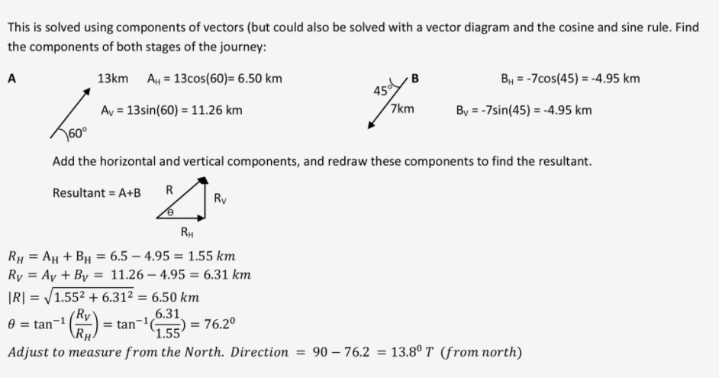
To use and manipulate vectors to represent forces
Resultant from two components

Slide 16
To use and manipulate vectors to represent forces
Resultant from two components
Use Pythagoras’ Theorem to find the magnitude
Use trigonometry to find the direction
R
R_{V} = 19
R_{H} = 14
Notes:
R = 23.6
Theta = 36.4 deg from vertical

Slide 17
To use and manipulate vectors to represent forces
Resultant from two components
Notes:
|R| = 94.9N
Theta = 18.4 perpendicular to the bank, with the current

Slide 18
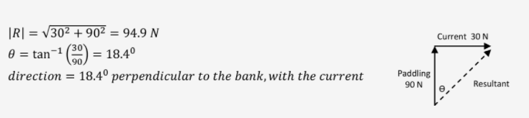
To use and manipulate vectors to represent forces
Resultant from two components
Notes:
|R| = 94.9N
Theta = 18.4 perpendicular to the bank, with the current

Slide 19
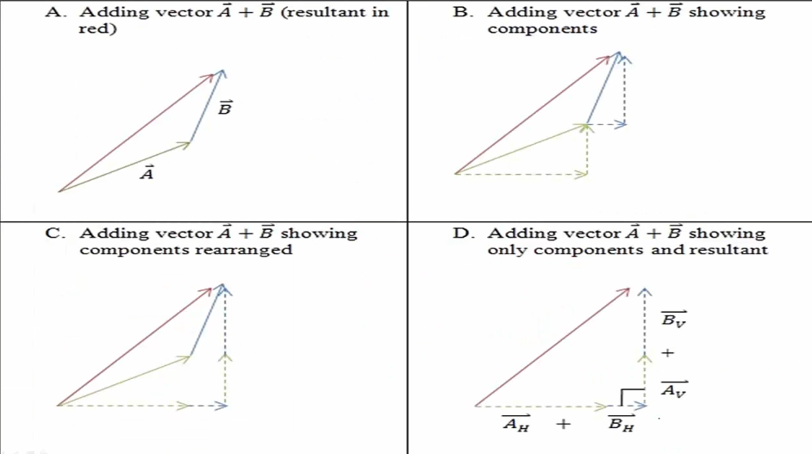
To use and manipulate vectors to represent forces
Resolving complex resultants
R
R_{V} = 19
R_{H} = 14

Slide 20
To use and manipulate vectors to represent forces
Resolving complex resultants

Slide 21
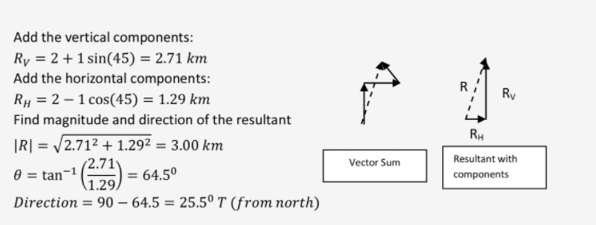
To use and manipulate vectors to represent forces
Resolving complex resultants

Slide 22
To use and manipulate vectors to represent forces
Resolving vectors
Back to the cannon: the cannonball is travelling at a velocity of 200 m/s at an angle of 30º from the horizontal.
What are the cannonball’s velocities in the horizontal and vertical direction?
velocity

Slide 23
To use and manipulate vectors to represent forces
Success Criteria
I can calculate a resultant vector.
I can resolve a resultant vector into its components.

